Slide 1
Sky-Rider
An OpenGL based aeroplane simulator game

Slide 2
INTRODUCTION
Welcome to the thrilling skies of SkyRider, an immersive airplane game that takes flight through the dynamic world of OpenGL graphics and the power-packed SOIL (Simple OpenGL Image Library) framework. SkyRider offers players an exhilarating experience, combining cutting-edge graphics and seamless gameplay to create a virtual aviation adventure like never before.
In the vast realm of computer graphics, OpenGL stands as a robust and widely used open-source graphics API (Application Programming Interface). Leveraging the capabilities of OpenGL, SkyRider introduces players to a visually stunning three-dimensional environment, where the skies are rendered with realistic clouds, dynamic lighting, and breathtaking landscapes. The game is a testament to the prowess of OpenGL in providing a rich and immersive graphical experience, ensuring players are captivated from takeoff to landing.
To enhance the visual appeal of SkyRider, the game integrates the SOIL library, a lightweight and efficient image-loading library specifically designed for use with OpenGL. SOIL simplifies the process of loading textures and images, allowing developers to focus on creating compelling visual content without the complexities of manual image loading and manipulation. With SOIL, SkyRider achieves seamless texture mapping, vibrant color representation, and smooth transitions, contributing to an engaging and visually appealing gameplay environment.

Slide 3
Players will find themselves at the helm of a high-flying aircraft, navigating through challenging terrains, evading obstacles, and engaging in heart-pounding aerial maneuvers. The combination of OpenGL and SOIL not only ensures a visually stunning experience but also provides a smooth and responsive interface, allowing players to fully immerse themselves in the adrenaline-pumping world of aviation.
SkyRider invites you to buckle up, take control, and soar through the skies in a gaming experience that showcases the incredible synergy between OpenGL graphics and the efficiency of the SOIL library. Get ready for an airborne adventure that pushes the boundaries of visual excellence and gameplay dynamics, delivering an unparalleled gaming experience for aviation enthusiasts and gamers alike.

Slide 4
Technology stack
OPENGL
C++ Language
Library Used :- SOIL , FREEGLUT, GLU32, GLEW32
VS CODE

Slide 5
Project Features
Realistic 3D Graphics:
Leveraging the power of OpenGL for immersive and visually stunning environments.
Dynamic lighting, realistic cloud formations, and vibrant landscapes enhance the gaming experience.
Interactive Gameplay:
Intuitive controls allowing players to take command of the airplane with ease.
Responsive handling for realistic aerial maneuvers.
Missile Dodging Mechanism:
Display of fuel perimeter to keep players informed about the remaining fuel.
Strategic decision-making as players must balance speed and fuel consumption.

Slide 6
Distance Traveled Tracking:
Ongoing calculation of the distance traveled by the airplane.
Encourages players to challenge themselves and aim for longer distances.
Scenic Landscapes:
Diverse and visually captivating landscapes as a backdrop for the gameplay.
Transitioning environments to keep the gaming experience fresh and exciting.
Fuel Management:
Display of fuel perimeter to keep players informed about the remaining fuel.
Strategic decision-making as players must balance speed and fuel consumption.
Responsive Performance:
Smooth and lag-free performance across different platforms.
Optimized gameplay experience for a wide range of devices.

Slide 7
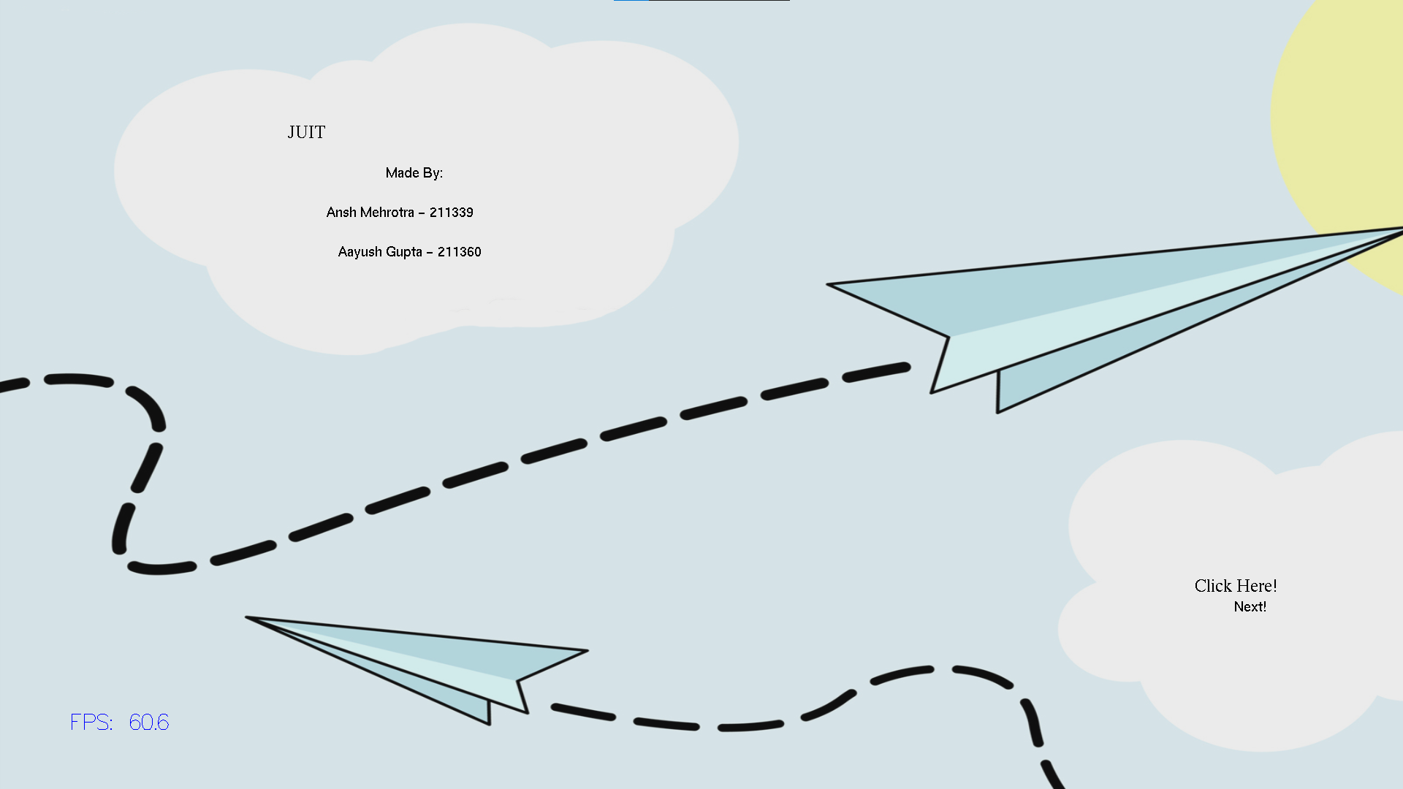
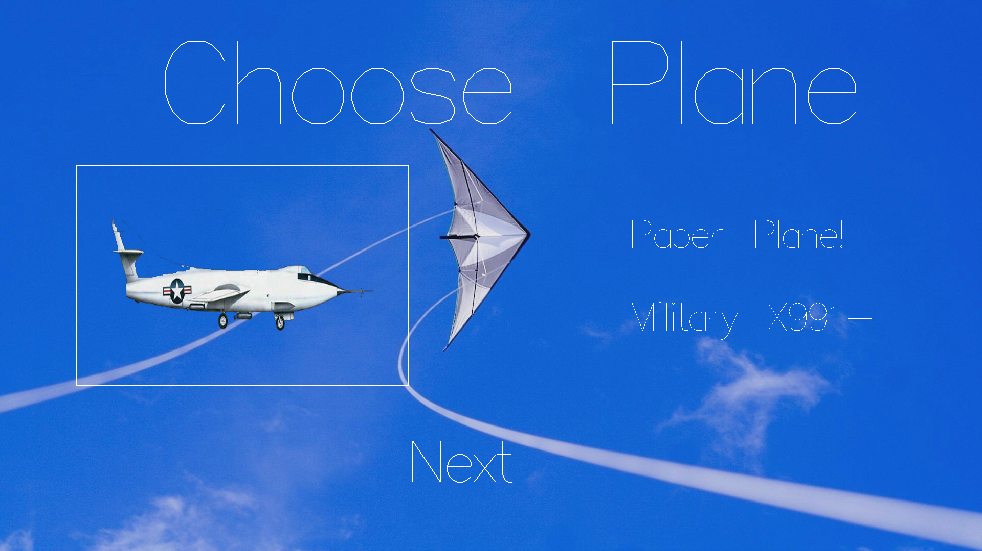
VISUALS

Slide 8
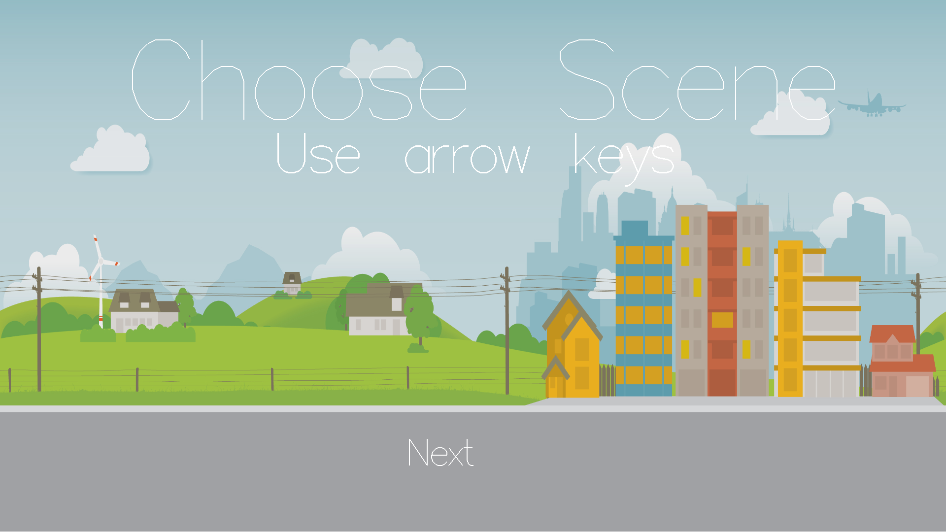
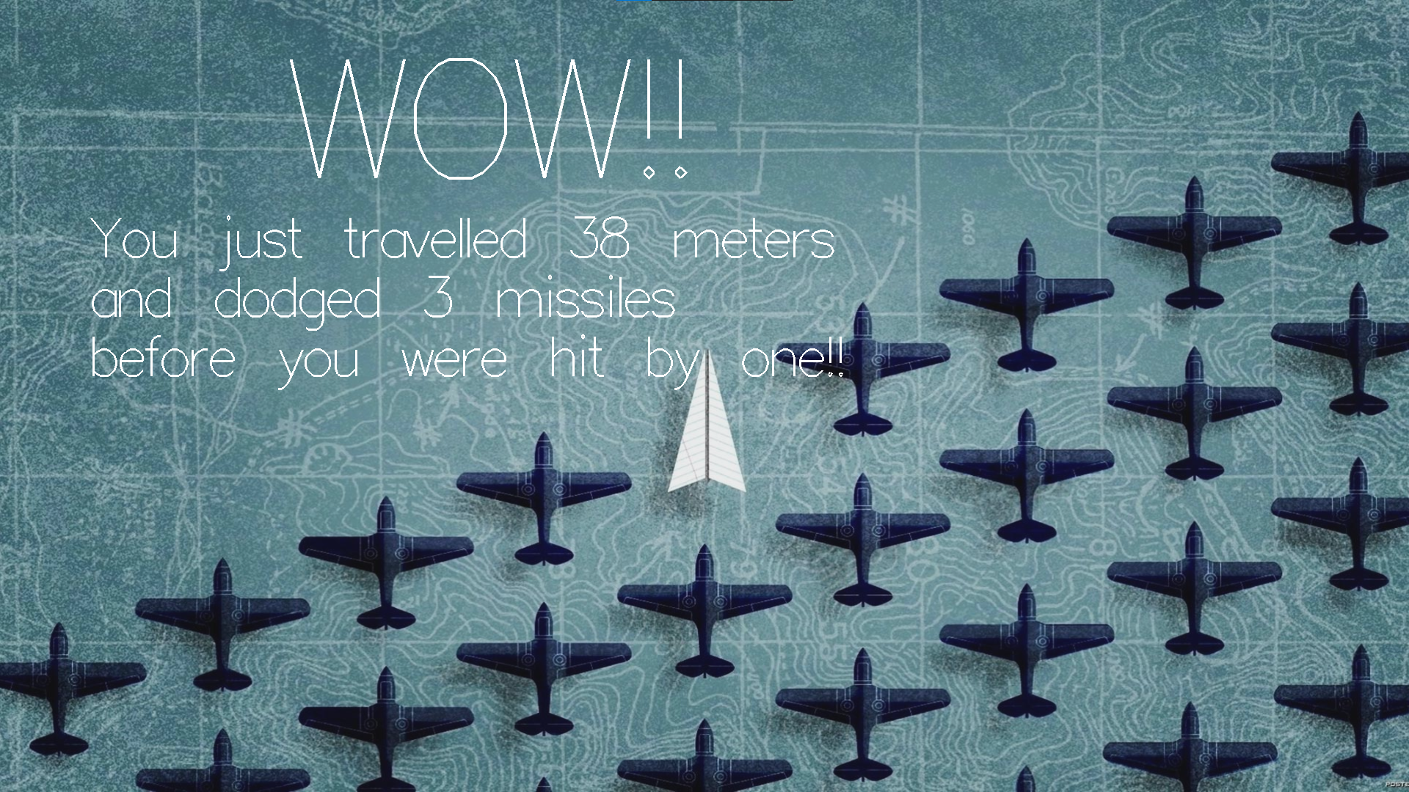

Slide 9
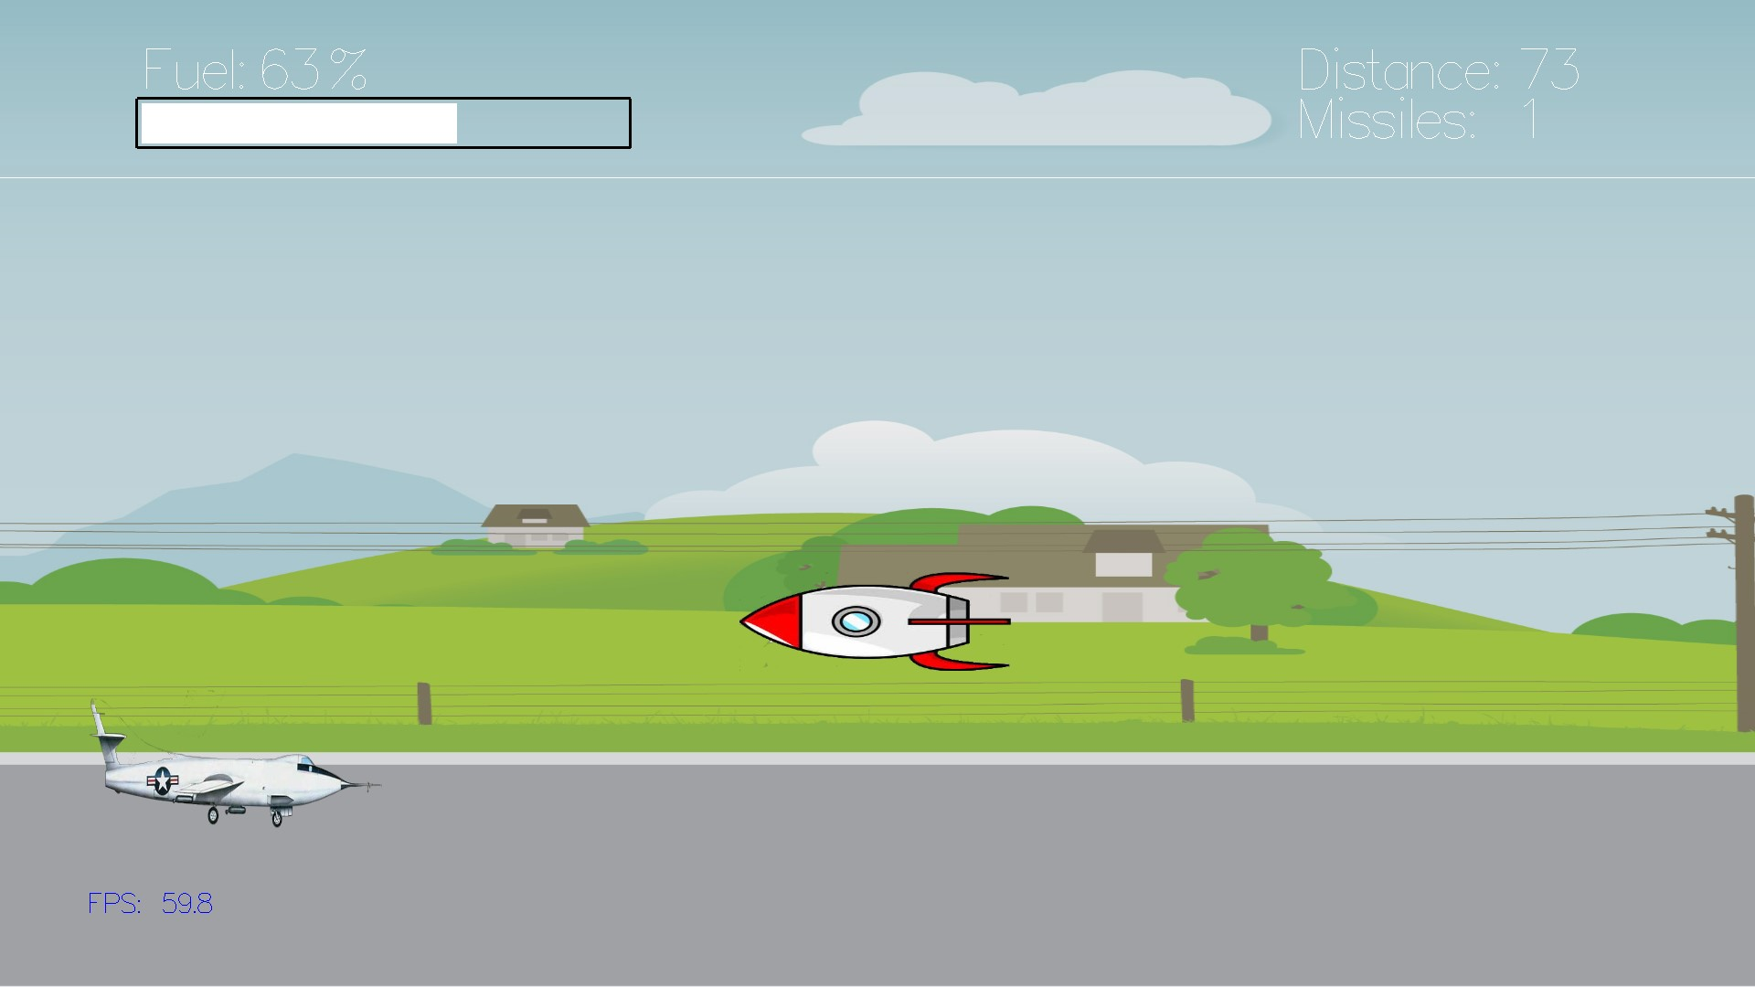

Slide 10
CONclusion
In the vast skies of SkyRider, players have embarked on an exhilarating journey through cutting-edge graphics and dynamic gameplay. The synergy of OpenGL and SOIL has brought to life a visually stunning world where dodging missiles, managing fuel, and calculating distance are the keys to survival. As the skies unfold, and players soar through diverse landscapes, the immersive experience is a testament to the seamless integration of technology. SkyRider not only challenges piloting skills but also offers a captivating adventure that lingers in the hearts of gamers. Get ready to conclude your flight, having left an indelible mark in the virtual skies.

Slide 11
Resources
https://www.opengl.org/
https://github.com/littlstar/soil
https://www.dll-files.com/glew32.dll.html
https://freeglut.sourceforge.net/
https://github.com/topics/opengl

